Slide 1

Children’s Book

Slide 2
Description of the book
I intend to create a children's book with interactive features, such as sound effects and the ability to make choices that impact the story, as well as the capability to scan QR codes to access specific websites, view images, or watch short videos. The entire storyline will be generated by ChatGPT, making it entirely AI-generated content. As an optional extension, we can explore tailoring the output based on user input; however, please note that such APIs may incur additional costs, so the default mode will be a static story.
The book's narrative will be a fantasy story set in South Korea, meeting this specific requirement. The details of the story itself will be determined by ChatGPT at a later stage. To visualize the book, I will develop a user-friendly interface with animations for page transitions. Ultimately, readers will experience different outcomes based on their decisions, including both happy and child-friendly sad endings. Each ending will be accompanie by an explanation of why it occurred.

Slide 3
Deliverable of the book and project
As a result of the book, the primary goal is to encourage children to reflect on their decisions and provide a learning experience for their daily lives.
Result of the Project:
A Python program capable of generating a simple, animated children's book with interactive features.
AI-generated code fragments to support the interactive elements and functionality of the book.
AI-generated images, sounds, and videos to enhance the visual and auditory aspects of the book.
An AI-generated story that forms the core narrative of the book.
Comprehensive documentation that outlines the technical aspects, usage, and generation process of the book.
These deliverables collectively form the outcome of the project, which aims to create an engaging and educational children's book with AI-driven interactivity and content.

Slide 4
Distribution of tasks
Team Roles:
Storyteller: Responsible for creating the storyline, defining the possible decision points in the narrative, considering various endings, and ensuring that the story conveys meaningful lessons for children.
Media Creator: In charge of designing the frontend of the book, creating visual assets such as images and videos that align with the story, and overall graphic design aspects of the project.
Programmer/Developer: Tasked with building the backend of the book using Python, integrating the story, and implementing the interactive elements and media created by the media creator.
Testing Team (All Together): This team will work collaboratively to ensure the overall coherence and educational value of the book. They will also be responsible for testing the program extensively to minimize bugs and ensure a smooth user experience.
Note: While these roles are distinct, there should be open communication and collaboration among team members to ensure the seamless integration of the story, media, and programming components.
With at least three people covering these roles, you can effectively manage and develop your AI-generated children's book project, ensuring a well-rounded final product.

Slide 5
Architecture
Story Generation:
Using Python-based AI models (e.g., ChatGPT) to generate the book's story.
Media Content Generation:
Utilizing AI tools such as DALL·E to generate images and media.
Frontend Design:
Using libraries like Pygame or PyQT for the frontend and user interface, as well as for designing and animating the book's pages.
Backend Development:
Python-based backend development for program logic and integration of AI-generated content.
Testing:
Thorough testing of the story and the application to minimize errors.
Deployment and Hosting:
Deployment on a local PC.

Slide 6
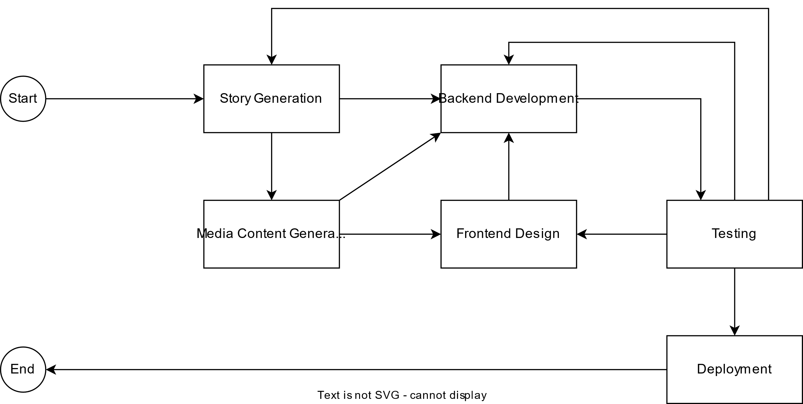
Architecture

